Slide 1
Computational Intelligence & Machine Learning (COMP7404) Group Project
Analysing Insider Transaction Accuracy in Hong Kong
Date: April 21, 2018
Ronald Leung
Chi Ho Wong
Gafung Fong
Jose Pun

Slide 2
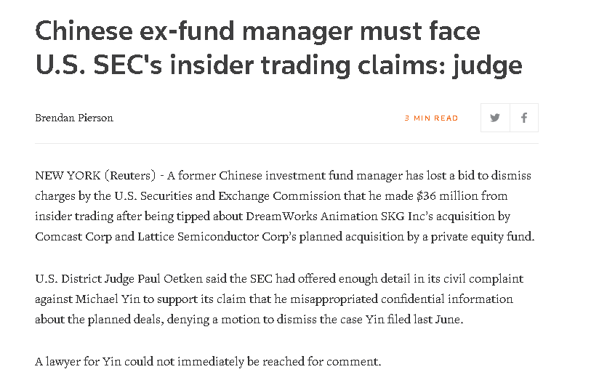
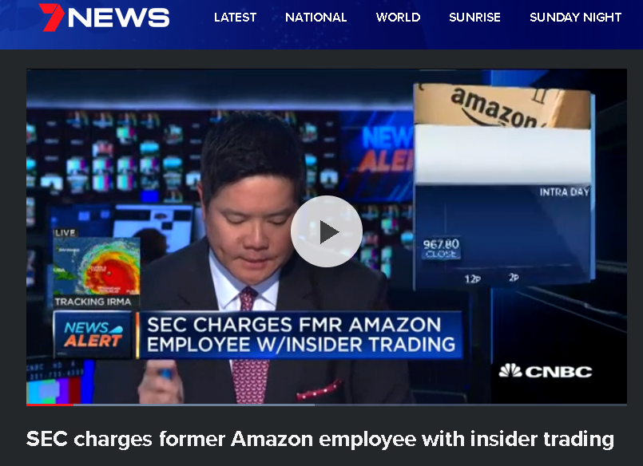
What is an insider? Is it legal?
Source: https://au.news.yahoo.com/video/watch/37005193/sec-charges-former-amazon-employee-with-insider-trading/
Source: https://au.news.yahoo.com/video/watch/37005193/sec-charges-former-amazon-employee-with-insider-trading/
Corporate Insiders are usually directors, managers, employees, beneficial owners (5% stake or above), and people affiliated with the firm
Insiders trading are not necessarily illegal as long as they report to exchange

Slide 3
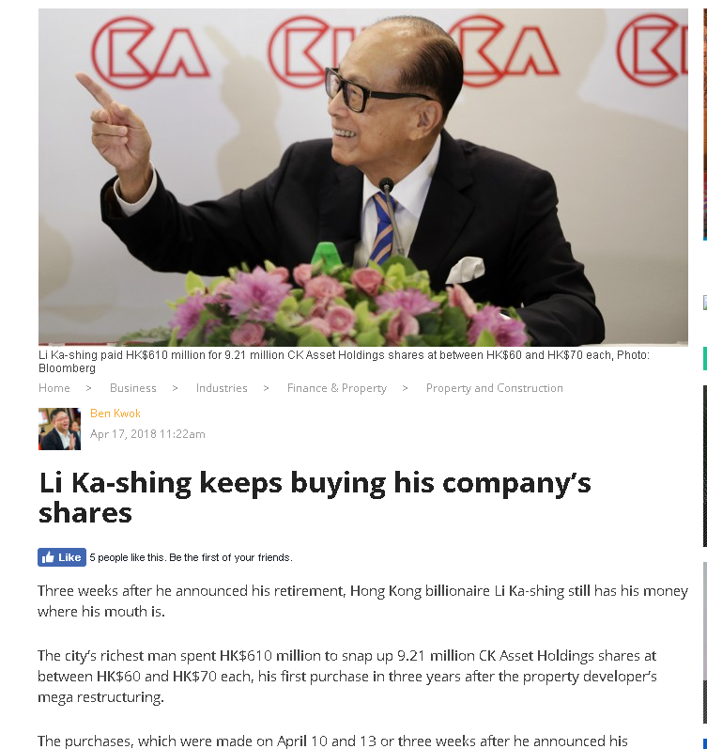
You may see these kinds of news from time to time….
Source:http://www.ejinsight.com/20180417-li-ka-shing-keeps-buying-his-company-s-shares/

Slide 4
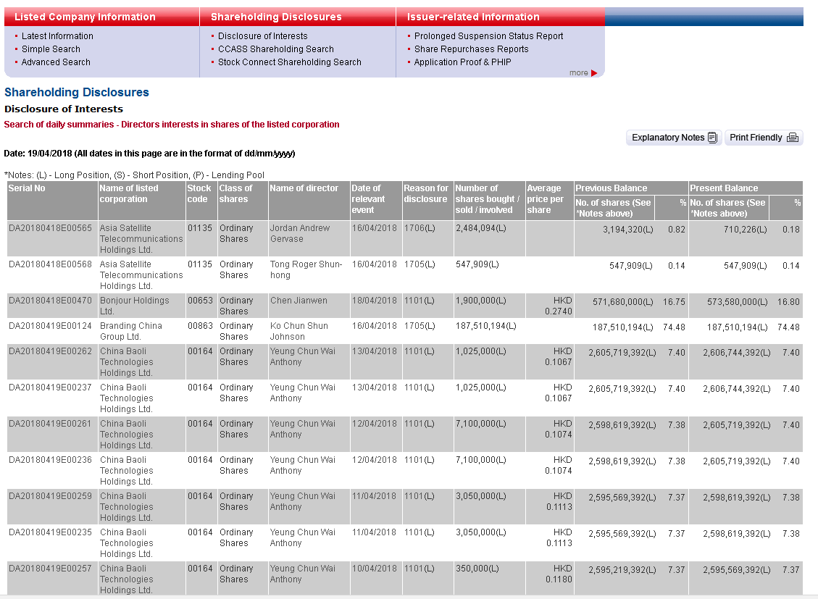
How do we know there is an insider transaction happening?
Source:http://sdinotice.hkex.com.hk/di/summary/DSM20180419C2.htm

Slide 5
Live demo on our application
We created a website which you can access to apply/test our trading strategy
-https://quiet-thicket-95158.herokuapp.com/
After entering the inputs (insiders purchase/selling data and other relevant data), it will generate a Buy/Sell output for you
You can find the insider purchase/selling data in HKEx website and David Webb's website
-http://www.hkexnews.hk/di/di.htm
-https://webb-site.com/

Slide 6
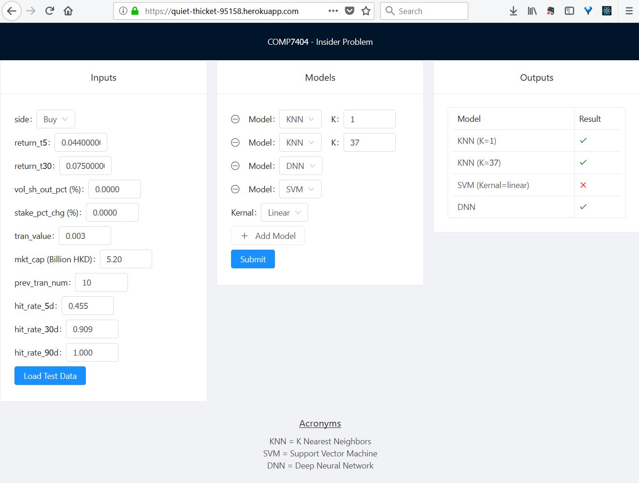

Slide 7
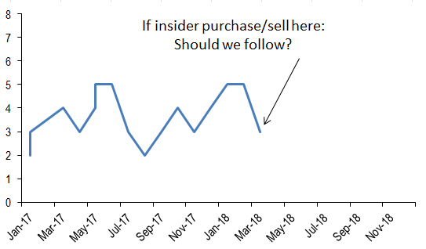

Computer Intelligence and Machine learning Group presentation
Machine learning techniques: K-Nearest Neighbors, Support Vector Machine, Deep Neural Network
Application/problems to solve: To analyze if an insider (management/director)'s purchase/selling of stocks would suggest a Buy/Sell signal for us
- Management/directors used to have better information than the general public
- If they use their own money to buy/sell stocks, it would signify a vote of confidence/no-confidence.

Slide 8
Summary of our presentation
1. To introduce a simple trading strategy which had a success score of 60%+ based on our analysis
2. To briefly introduce various machine learning techniques (KNN, SVM, DNN) which were not covered in our lecture.
3. To compare and explain the results of various techniques in our application; Highlight the limitations of each technique

Slide 9
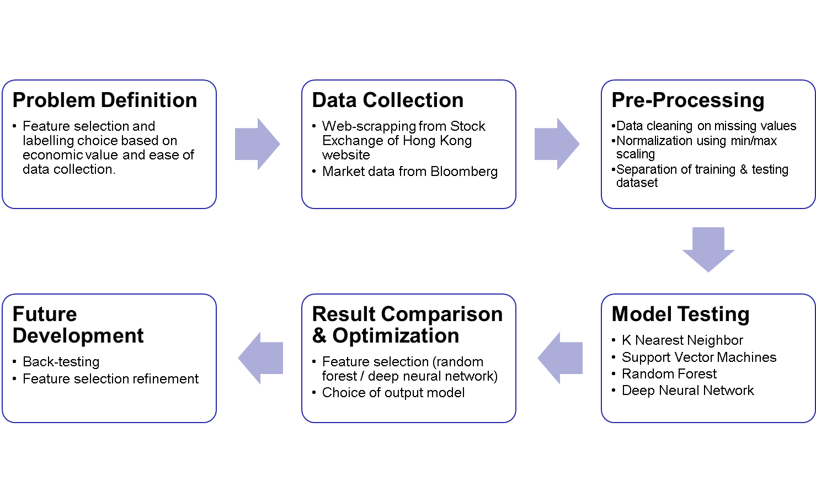
Analytical flow

Slide 10
Features and Labels Definition
Features
Name | Data Type | Description
side | Binary | 1 = Buy, -1 = Sell
return_t5 | Float | Price change 5 days before the transaction.
return_t30 | Float | Price change 30 days before the transaction.
vol_sh_out_pct | Float | Size of transaction relative to the total outstanding share in percentage.
stakepct | Float | Percentage of stake held by director in the company.
stake_pct_chg | Float | Percentage change of stake holding by the director. If the director does not own any shares before transaction, put as 0.
mkt_cap | Float | Market capitalization of the stock at the day of transaction. Unit: billions HKD.
prev_tran_num | Integer | Number of transaction from the same director trading the same stock on the same side (buy or sell) in the past.
hit_rate_5d | Float | If current side is Buy, return the number of positive 5d return on all previous buy transaction by the same director on the same stock, divided by “prev_tran_num”. Vice versa for sell.
hit_rate_30d | Float | Same as hit_rate_5d but replaced with 30d.
hit_rate_90d | Float | Same as hit_rate_5d but replaced with 90d.
Labels
Name | Data Type | Description
Return5d | Binary | 1 = positive 5 day return after transaction date, -1 = negative 5 day return after transaction date
Return30d | Binary | 1 = positive 30 day return after transaction date, -1 = negative 30 day return after transaction date
Return90d | Binary | 1 = positive 90 day return after transaction date, -1 = negative 90 day return after transaction date

Slide 11
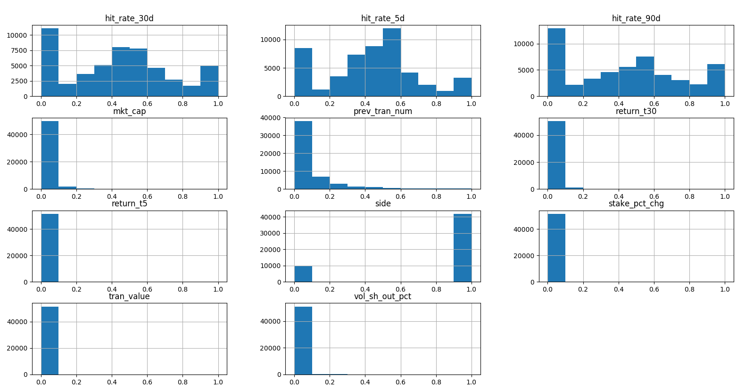
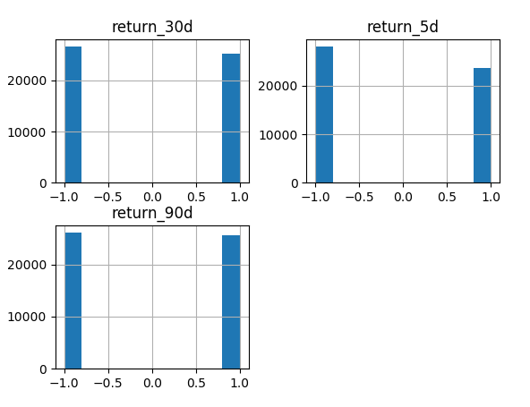
Data Pre-Processing
We applied min/max scaling to all the features for normalization.
We observe certain features have long tail in distribution. Labels are quite evenly distributed.
We split 2/3 of total data to be training set and 1/3 to be testing set chronologically.
Features after scaling
Labels

Slide 12
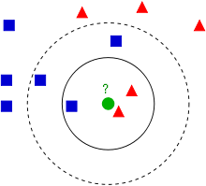
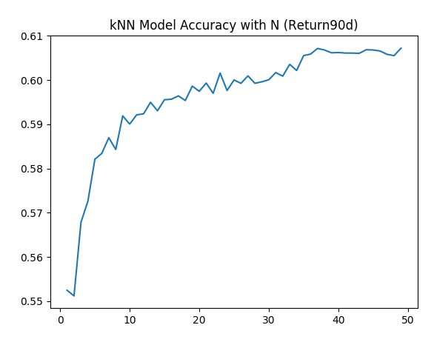
k-nearest neighbors (kNN)
Concept: an object is classified by a majority vote of its neighbor.
Model result: kNN prediction score increases as time horizon increases (90d>30d>5d) and as N increases. Best result from our model is when N=37.
Implication: Information value from director transaction may take time to realize.
Pros/Cons: very easy to use and fast, but no information on feature importance unless we solve a search problem to identify the optimal sub-set of features.
Output Label | kNN Score
Return5d | 54.2
Return30d | 58.1
Return90d | 60.7
Source: Wikipedia

Slide 13
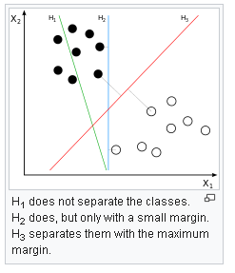
Support Vector Machine (SVM)
Concept:
  find out a boundary (hyperplane) that maximizes the distance between classes.
  Map the data into a higher dimensional space if boundary is not linear, a choice of mapping function (kernel) is required.
Model result:
  Prediction score increases as time horizon increases (90d>30d>5d)
  Polynomial kernel works better than others
  Gamma (radius influence) works well with default setting (1/#features)
Source: Wikipedia
Output Label | SVM Score
Return5d | 56.2
Return30d | 59.1
Return90d | 61.5
Kernel Choice | SVM Score (Return90d)
Linear | 57.6
Poly | 62.7
RBF | 61.5
Sigmoid | 51.7
Gamma | SVM Score (Return90d)
0.01 | 49.3
0.1 | 62.6
1 | 60.8

Slide 14
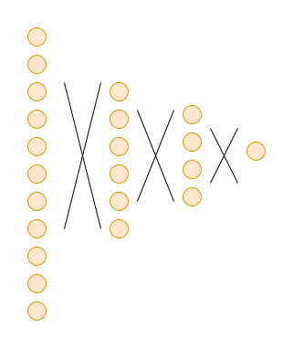
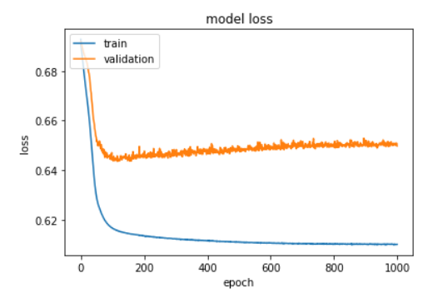
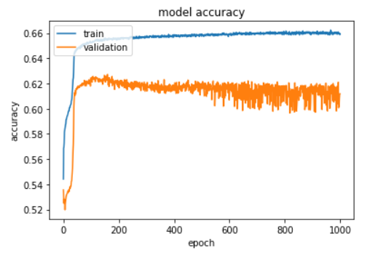
Deep Neural Network (DNN)
Concept: Reduce loss by changing weights of neuron connections
Result: Accuracy does not improve after 300 epochs.
Changing #hidden layers and batch size does not help
( 2 hid. layers; 128 batch size )
Return5d
56.7
Return30d
60.0
Return90d
63.1
Output Label | Score
Return5d | 57.1
Return30d | 60.0
Return90d | 63.8
Hidden layers | Score
1 (11->4->1) | 63.8
2 (11->6->4->1) | 63.1
Batch Size | Score
64 | 63.4
128 | 63.8
256 | 63.1
If not specified:
1 hidden layer, Return90d, batch size 128, learning rate 0.01, epochs 1000, activation relu+sigmoid,
Optimizer stochastic gradient descent, Loss Function binary cross entropy, Validation Split 20%

Slide 15
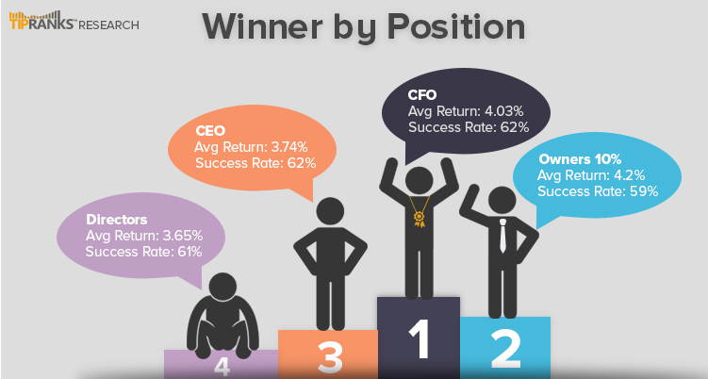
Comparison of results
All models show improving result as time horizon increases. DNN outperforms SVM and SVM outperforms kNN in all three labels.
Following insider transaction is a popular investment strategy in the US. For example, TipRanks offers subscription services to receive insider transaction stock picks in US. They claim to have a success ratio of 59%-62%.
https://blog.tipranks.com/profit-insider-trading/
 | Return5d | Return30d | Return90d
kNN | 54.2 | 58.1 | 60.7
SVM | 56.2 | 59.1 | 61.5
DNN | 57.1 | 60.0 | 63.8
Source: https://blog.tipranks.com/profit-insider-trading/

Slide 16
Alternative video presentation
Video to briefly describe K-Nearest Neighbour
Link and QR code to our youtube video:

Slide 17
References and sources
Historical insider purchase data: Hong Kong Exchange (www.hkexnews.hk)
Pricing data: Bloomberg
US insider transaction accuracy: TipRanks Research (https://blog.tipranks.com/profit-insider-trading/)
Libraries for Research & Live Demo:
  Keras - https://keras.io/
  TensorFlow - https://www.tensorflow.org/
  Scikit-Learn - http://scikit-learn.org/
  NumPy - http://www.numpy.org/
  Pandas - https://pandas.pydata.org/
  h5py - https://www.h5py.org/
  Jupyter Notebook - http://jupyter.org/
  React.js - https://reactjs.org/
  Ant Design - https://ant.design/
  Flask - http://flask.pocoo.org/
  Gunicorn - http://gunicorn.org/
Hosting Service: Heroku - https://www.heroku.com/

